Slide 1
UNet++: A Nested U-Net Architecture for Medical Image Segmentation
Zongwei Zhou, DLMIA, 2018
Saebom Lee

Slide 2
Abstract
A deeply-supervised encoder-decoder network where the encoder and decoder sub-networks are connected through a series of nested and dense skip pathways.
Unet++
Aim at reducing the semantic gap between the feature maps of the encoder and decoder sub-networks.
Re-designed skip pathways
An average IOU gain of 3.9 point over U-Net

Slide 3
Contents
Sec1. Introduction
Sec2. Related Work
Sec3. Proposed Network Architecture: Unet++
Sec4. Experiments
Sec5. Conclusion

Slide 4
Sec1. Introduction

Slide 5
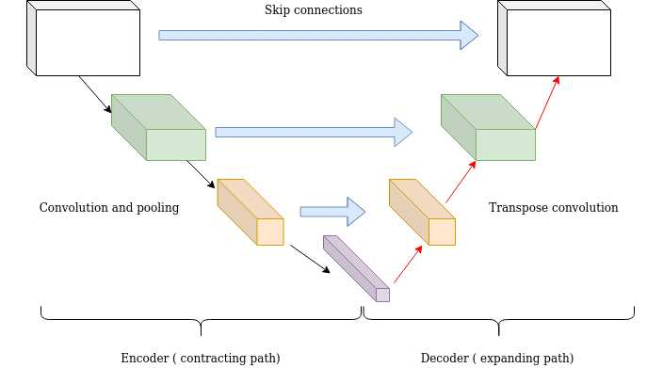
Introduction
Paragraph 01
An encoder-decoder network like U-Net and full convolutional network (FCN) used for segmentation share a key similarity: skip connections.
The skip connections have proved effective in recovering fine-grained details of the target objects; generating segmentation masks with fine details even on complex background.
Paragraph 02
Segmenting lesions or abnormalities in medical images demands a higher level of accuracy than what is desired in natural images.
It is therefore desired to devise more effective image segmentation architectures that can effectively recover the fine details of the target objects in medical images.

Slide 6
Introduction
Paragraph 03
To address the need for more accurate segmentation in medical images, we present UNet++, a new segmentation architecture based on nested and dense skip connections.
The underlying hypothesis behind our architecture is that the model can more effectively capture fine-grained details of the foreground objects when high-resolution feature maps from the encoder network are gradually enriched prior to fusion with the corresponding semantically rich feature maps from the decoder network.
We argue that the network would deal with an easier learning task when the feature maps from the decoder and encoder networks are semantically similar.

Slide 7
Sec3. Proposed Network Architecture: Unet++
Sec3-1. Re-designed skip pathways
Sec3-2. Deep supervision

Slide 8
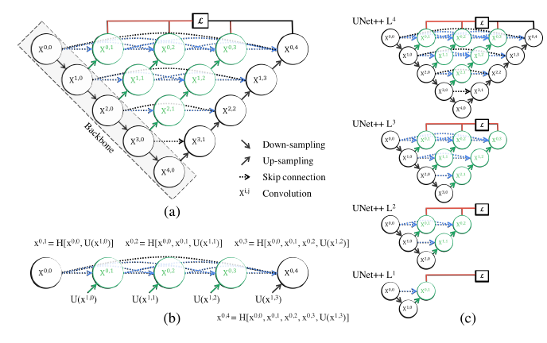
Proposed Network Architecture: Unet++
Deep supervision
+
Re-designed skip pathways
Notes:
Deep supervision(shown red)
+
Re-designed skip pathways(shown in green and blue)

Slide 9

Re-designed skip pathways
Xi,j: i-> the down-sampling layer, j -> the convolution layer of the dense block
H(.) : a convolution operation followed by an activation function
U(.) : an up-sampling layer
[ ] : the concatenation layer.
Notes:
Re-designed skip pathways(shown in green and blue)

Slide 10
Re-designed skip pathways
nodes at level j = 0 receive only one input from the previous layer of the encoder
Notes:
j=0일때는 이전 계층의 노드를 convolution down sampling한 결과를 얻어낸다.

Slide 11

Re-designed skip pathways
nodes at level j = 1 receive two inputs, both from the encoder sub-network but at two consecutive levels
Notes:
X노드 I, 0 인풋과 x(i+1,0)의 업샘플링한 노드 총 2개의 input을 concat해주고, convolution 한 결과가 됨.

Slide 12
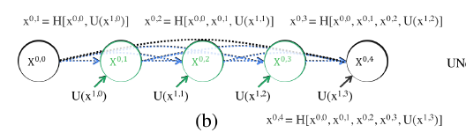
Re-designed skip pathways
nodes at level j > 1 receive j +1 inputs
Notes:
X노드 I, K부터 j-1의 인풋과 x(i+1,j-1)의 업샘플링한 노드 총 j+1개의 input을 concat해주고, convolution 한 결과가 됨.

Slide 13
Deep supervision
We propose to use deep supervision in UNet++, enabling the model to operate in two modes:
accurate mode wherein the outputs from all segmentation branches are averaged
fast mode wherein the final segmentation map is selected from only one of the segmentation branches, the choice of which determines the extent of model pruning and speed gain.
Notes:
U-net++에서는 deep supervision을 사용하여 모델이 두 가지 mode로 작동할 수 있도록 함
모든 segmentation branch의 출력을 평균하는 accurate 모드
최종 segmentation map 분기 중 하나만 선택되는 fast 모드. 이 모드의 선택은 모델 pruning 및 speed gain의 범위를 결정합니다
=> L1 ->

Slide 14

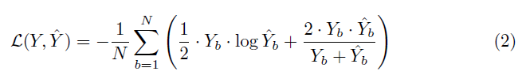

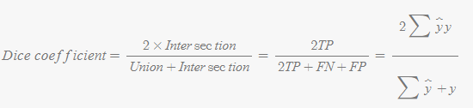
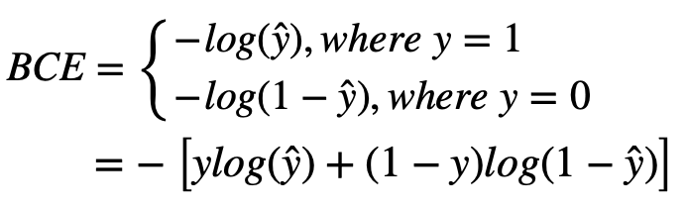
Deep supervision
Owing to the nested skip pathways, UNet++ generates full resolution feature maps at multiple semantic levels,
We have added a combination of binary cross-entropy and dice coefficient as the loss function to each of the above four semantic levels, which is described as:
:
:
Notes:
Deep Supervision은 여러 Semantic Level(위 구조에서는 4개)은 각각 Feature map을 생성하여 정보를 가지고 있습니다. 따라서, 4개의 시맨틱 정보를 모두 이용하여 평균내어 결과를 예측하였습니다

Slide 15
Unet++
In summary, as depicted in Fig. 1a, UNet++ differs from the original U-Net in three ways:
1) having convolution layers on skip pathways (shown in green), which bridges the semantic gap between encoder and decoder feature maps.
2) having dense skip connections on skip pathways (shown in blue), which improves gradient flow.
3) having deep supervision (shown in red) , which as will be shown in Section 4 enables model pruning and improves or in the worst case achieves comparable performance to using only one loss layer.
Notes:
스킵 경로에 컨볼루션 레이어가 있습니다. 이는 인코더 및 디코더 특성 맵 사이의 시맨틱 갭을 연결합니다.
스킵 경로에 Dense 스킵 연결이 있습니다. 이는 그라디언트 흐름을 향상시킵니다.
**모델 pruning을 가능하게 하는, 딥 슈퍼비전(deep supervision)**이 있고, 성능을 향상시키거나, 최악의 경우 손실 레이어 하나만 사용하는 것과 비교할만한 성능을 달성합니다.

Slide 16
Sec4. Experiments

Slide 17
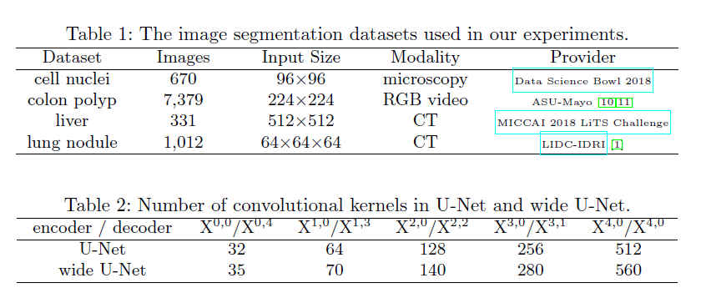
Experiments
Notes:
Table 1-> 다양한 dataset 사용 해봄
Table 2 -> 비교를 위해 original unet wide unet 사용

Slide 18
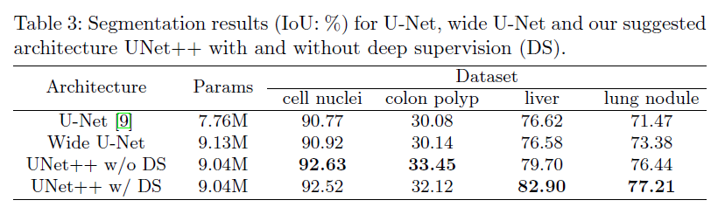
Experiments
Notes:
U-net보다 wide unet이 성능이 좋음-> Parameter가 많을 수록 성능 더 좋음
Without deep supervision
With deep supervision
Liver 는 video frame에서 multi scale이기 때문에 segmentation branches(deep supervision) 이 더 효과적으로 나타남

Slide 19
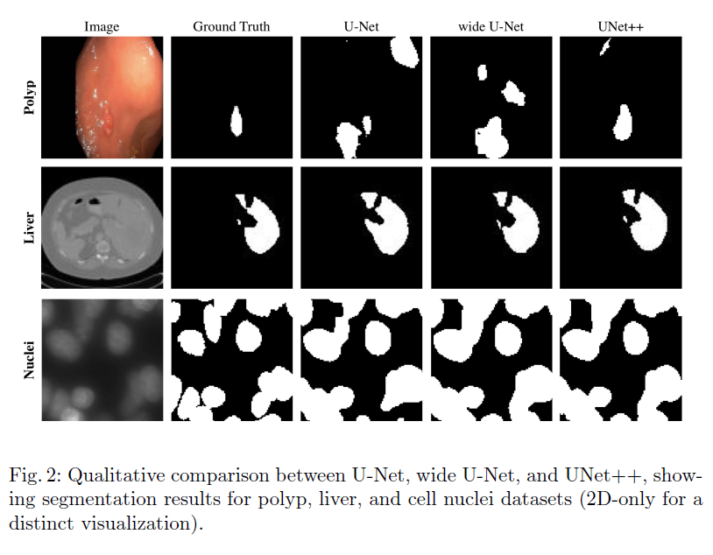
Experiments

Slide 20
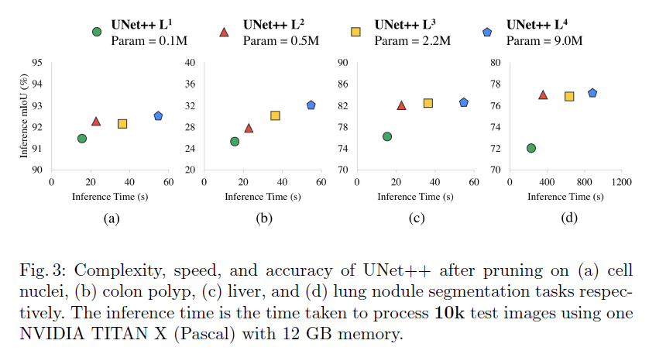
Experiments
Notes:
Pruning
i-> pruned at level i

Slide 21
Sec5. Conclusion

Slide 22
Conclusion
To address the need for more accurate medical image segmentation, we proposed UNet++. The suggested architecture takes advantage of re-designed skip pathways and deep supervision.
The re-designed skip pathways aim at reducing the semantic gap between the feature maps of the encoder and decoder sub-networks, resulting in a possibly simpler optimization problem for the optimizer to solve.
Our experiments demonstrated that UNet++ with deep supervision achieved an average IoU gain of 3.9 and 3.4 points over U-Net and wide U-Net, respectively.
Notes:
보다 정확한 의료 영상 segmentation을 위해 UNet++를 제안, unet++ -> re-designed skip pathways + deep supervision
Re-designed skip pathways => subnetwork 의 feature map 사이의 semantic gap을 줄이는 것을 목표, optimazation을 더 간단하게 함.

Slide 23
Source Code

Slide 24
Source Code
Framework : pytorch
Code location : https://github.com/4uiiurz1/pytorch-nested-unet
This code was tested with python 3.7, cuda 11.3 and pytorch 1.10.1 on NVDIA RTX3060 (12GB).

Slide 25
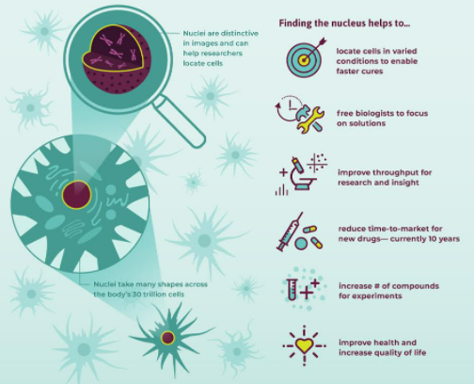

Source Code

Slide 26

Source Code
Preprocess_dsb2018
Train the model
Evaluate
Notes:
Img및 mask resize해주고 폴더 만들어 줌

Slide 27
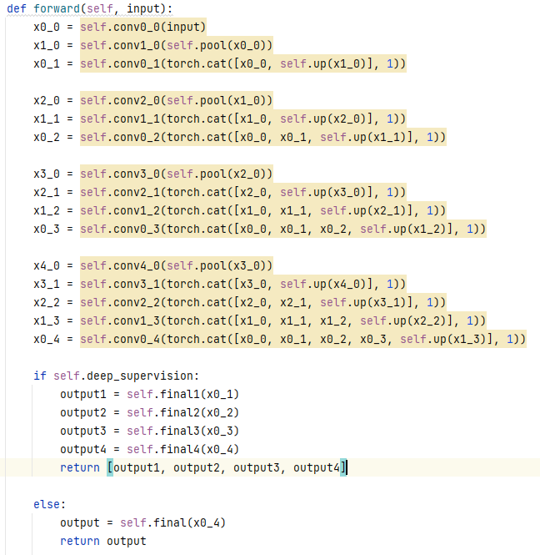
Source Code
NestedUNet

Slide 28
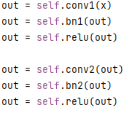
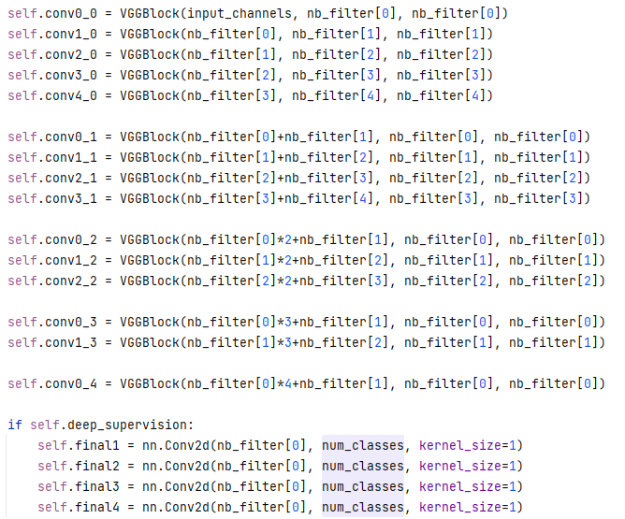
Source Code
NestedUNet
Notes:
Vgg block 구성

Slide 29
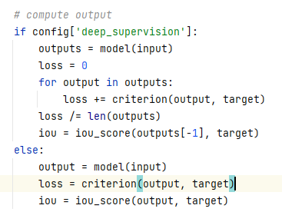
Source Code
Train the model
Notes:
Deep supervision

Slide 30
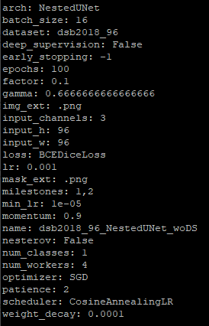
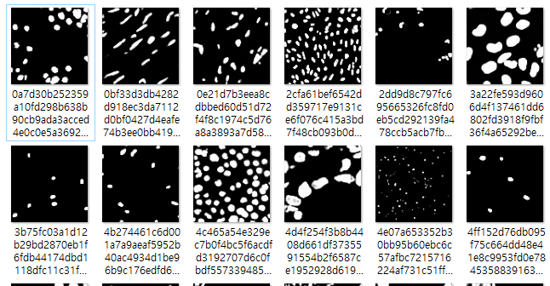
Source Code
Preprocess_dsb2018
Train the model
Evaluate
Notes:
Img및 mask resize해주고 폴더 만들어 줌

Slide 31
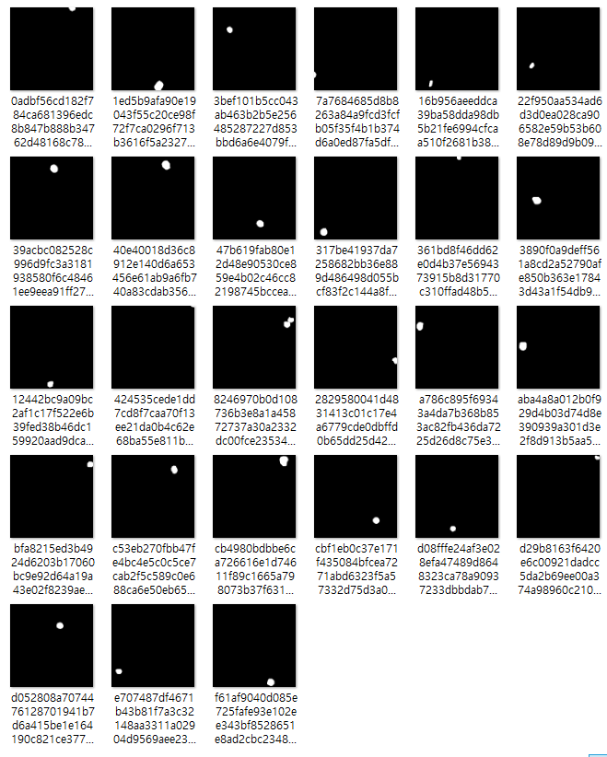
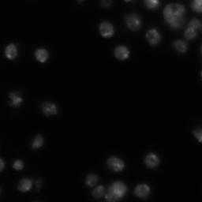

Source Code
images
masks
predict
Notes:
Img및 mask resize해주고 폴더 만들어 줌

Slide 32
Thank you

